Slide 1

Sepsis Risk Prediction Models Using Patient Health Records
Asritha Suraparaju,
Greeshma Poli,
Ramya Reddy Baapathu,
Veena Chebrolu,
Pallavi vallepally

Slide 2

Table of Contents
Introduction
Data Description
Data Attributes
Feature Selection
Data Visualization
Linear Regression
KNN Classification
Naïve Bayes Classification
SVM Models and Kernels
SVM Classifier
Interpretation
Result

Slide 3

INTRODUCTION
Sepsis is a severe and life-threatening condition triggered by the body’s dysregulated immune response to infection, which can lead to organ dysfunction and high mortality rates. Timely recognition and treatment of sepsis are crucial to improving survival outcomes. In critical care settings, large amounts of patient data including vital signs, laboratory results, comorbidities, and demographics are collected. Machine learning offers the opportunity to leverage this data for the early prediction of sepsis, potentially enabling proactive interventions and reducing healthcare burdens. This project utilizes a synthetic clinical dataset containing demographic, vital, and laboratory measurements to develop predictive models for sepsis. The goal is to identify risk factors and build a reliable classification model that distinguishes sepsis cases from non-sepsis cases, aiding in early detection.

Slide 4

Data Description
Source: Synthetic Clinical Dataset (generated for academic and research use) Link: https://www.kaggle.com/datasets/uom190346a/synthetic-clinical-tabular-dataset?resource=download Number of Records: 10,000 Number of Features: 14
Description: This dataset contains synthetic patient-level clinical records, including demographics, vital signs, laboratory test results, comorbidities, and outcomes. It is designed to study the onset and prediction of sepsis and related outcomes such as readmission and mortality. The data reflects real-world healthcare settings and provides a foundation for training and evaluating machine learning models for early sepsis detection.
Features:
Vital signs: Systolic Blood Pressure, Diastolic Blood Pressure
Laboratory results: Glucose, Cholesterol, Creatinine
Demographics: Age, Sex, Body Mass Index (BMI)
Comorbidities: Diabetes, Hypertension
Outcomes: Diagnosis (Normal, Sepsis, Heart Failure, etc.), 30-day Readmission, Mortality
Target Variable:
Diagnosis (with focus on identifying Sepsis cases)
Objective: The primary goal is to use patient demographics, vital signs, laboratory values, and comorbidities to enable the early detection of sepsis in clinical patients. By applying machine learning methods to this dataset, the project aims to support timely interventions, improve patient management, and reduce sepsis-related mortality.

Slide 5

Data Attributes (Column Names)
Patient_id – Unique identifier for each patient.
Age – Age of the patient (in years).
Sex – Gender of the patient (Male/Female).
BMI – Body Mass Index (kg/m²), a measure of body fat based on weight and height.
Systolic_bp – Systolic blood pressure (mmHg).
Diastolic_bp – Diastolic blood pressure (mmHg).
Glucose – Blood glucose level (mg/dL).
Cholesterol – Blood cholesterol level (mg/dL).
Creatinine – Serum creatinine level (mg/dL), an indicator of kidney function.
Diabetes – Presence of diabetes (0 = No, 1 = Yes).
Hypertension – Presence of hypertension (0 = No, 1 = Yes).
Diagnosis – Primary clinical diagnosis (e.g., Sepsis, Heart Failure, Normal).
Readmission_30d – Hospital readmission within 30 days (0 = No, 1 = Yes).
Mortality – Patient mortality outcome (0 = Survived, 1 = Died).

Slide 6
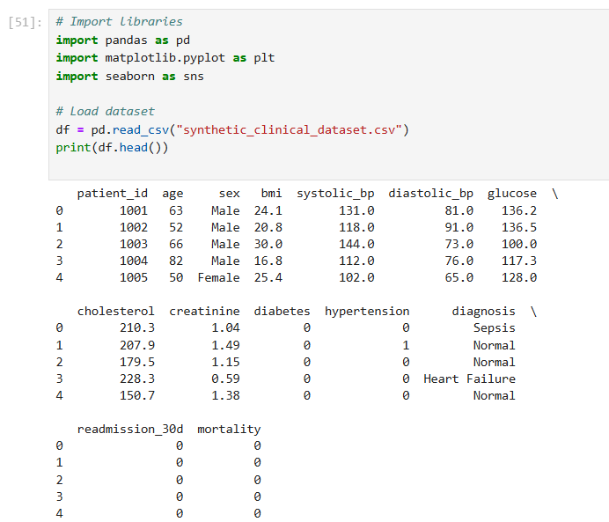

Slide 7
Feature Selection
Based on the dataset attributes, we selected three important features Age (Numerical)
Age is a critical clinical factor, as older patients are more vulnerable to infections and sepsis.
It helps us understand the demographic risk distribution.
Glucose (Numerical)
Abnormal or high glucose levels are often linked to infection severity and complications.
It is also relevant for patients with diabetes, who are at higher risk of sepsis.
Diagnosis (Categorical)
This is the outcome/target variable (Normal, Sepsis, Heart Failure, etc.).
It allows comparison of numerical features (Age, Glucose) across different patient groups.

Slide 8
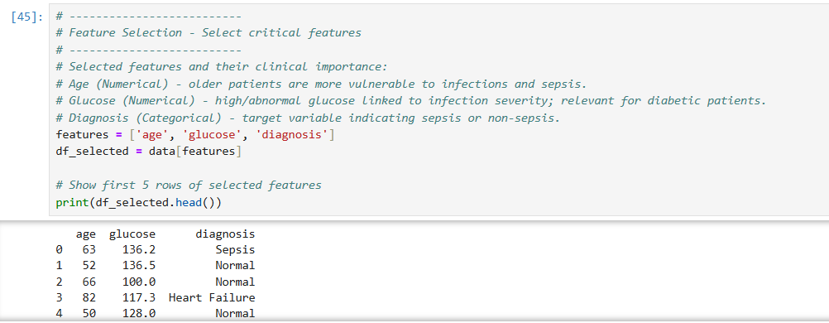

Slide 9
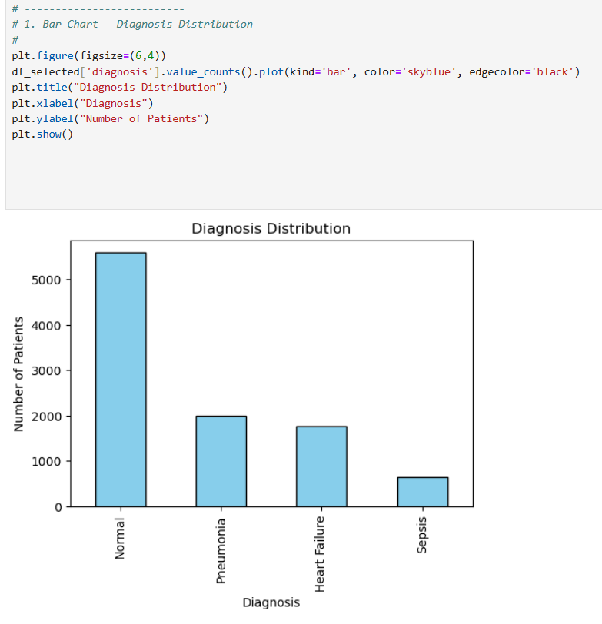
Interpretation of Diagnosis Distribution: The bar chart displays the frequency of different diagnoses. The "Normal" diagnosis is the most prevalent, with a count of over 5,000, dwarfing all other categories. "Pneumonia" and "Heart Failure" are the next most common diagnoses, while "Sepsis" is the least frequent diagnosis in this dataset.
Data Visualization

Slide 10
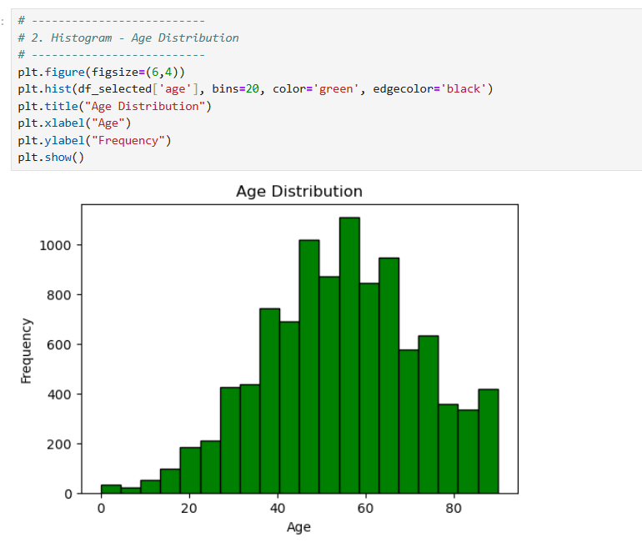
Interpretation of Age Distribution Histogram:
The histogram displays the distribution of ages within the dataset. It shows a roughly normal distribution, with the majority of the population clustered around the center of the age range. The most frequent age group appears to be between 50 and 60 years, with a peak just below 60. The frequencies decrease as ages move toward the lower and higher ends of the spectrum, indicating fewer people in the youngest and oldest age brackets.

Slide 11
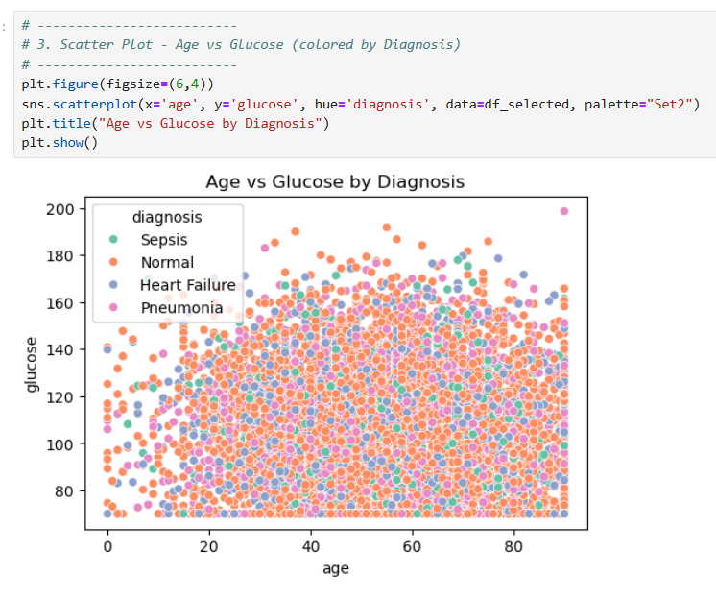
Interpretation of Age vs. Glucose by Diagnosis Scatter Plot:
This scatter plot shows the relationship between a patient's age and their glucose level, with points colored according to their diagnosis.
There appears to be no strong correlation between age and glucose levels for any of the diagnoses. The data points are widely scattered across the plot, indicating that a patient's age doesn't consistently predict their glucose level.
When analyzing by diagnosis, the plot shows a significant overlap of data points for all four categories (Sepsis, Normal, Heart Failure, and Pneumonia). This suggests that a patient's age and glucose level, when viewed together, aren't strong predictors of their diagnosis. In other words, a person with a high glucose level and a high age is just as likely to be diagnosed as "Normal" as they are with one of the other conditions shown here.

Slide 12
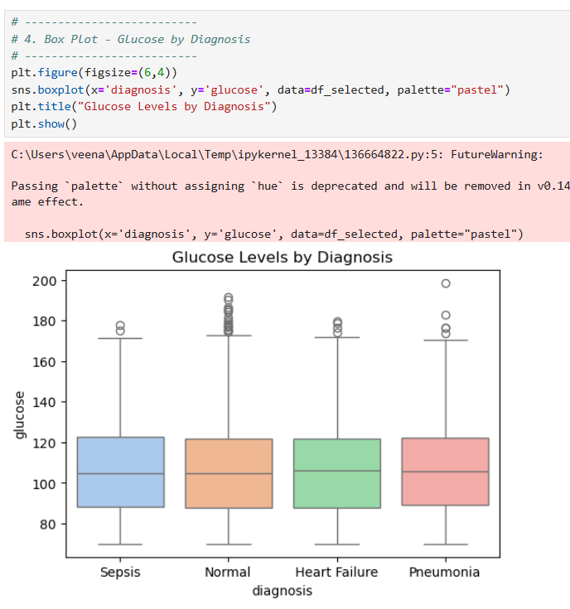
Interpretation of Glucose Levels by Diagnosis Box Plot:
The box plot shows the distribution of glucose levels for each diagnosis category.
All four diagnoses (Sepsis, Normal, Heart Failure, Pneumonia) have a similar median glucose level, hovering around 100-110. This suggests that, on average, glucose levels aren't drastically different across these conditions.
The interquartile ranges (the boxes) are also quite similar for all groups, indicating a consistent spread of glucose levels for the middle 50% of the patients.
All groups have a notable number of outliers (the points above and below the whiskers), particularly at higher glucose levels. This suggests that while the bulk of the data is similar, there are individual patients in each diagnosis category who have unusually high or low glucose readings.

Slide 13
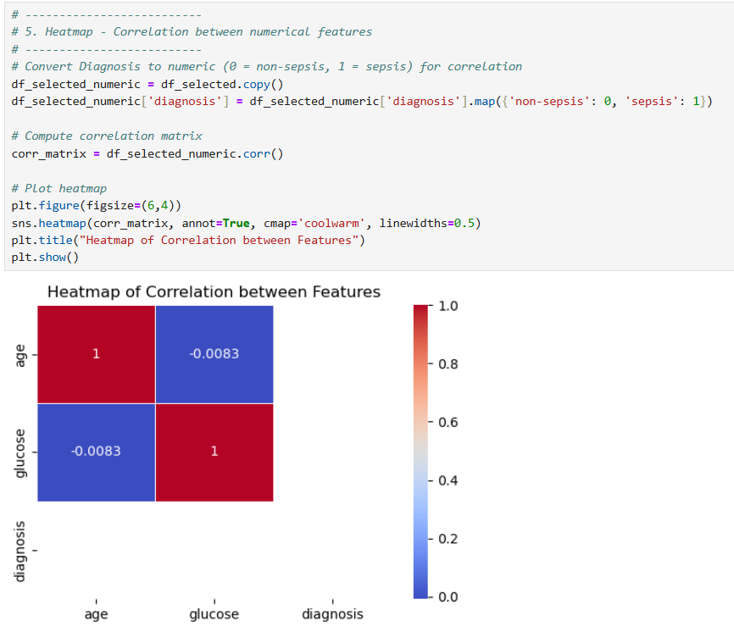
Interpretation of the Correlation Heatmap: The heatmap visualizes the correlation between age, glucose, and a binary diagnosis variable (where Sepsis is 1 and all other diagnoses are 0).
The key findings are: Age and Age: The correlation is 1.0, which is expected as any variable is perfectly correlated with itself. Glucose and Glucose: The correlation is also 1.0, for the same reason. Age and Glucose: The correlation is a very weak -0.0083, indicating there is virtually no linear relationship between a person's age and their glucose level. Age and Diagnosis: The correlation is -0.0083, a very weak negative value. This suggests age is not a good linear predictor of whether a patient has sepsis. Glucose and Diagnosis: The correlation is also -0.0083. This indicates that there's also no significant linear relationship between glucose levels and a sepsis diagnosis.
In summary, none of the variables are strongly correlated with each other, meaning that for this dataset, age and glucose are not reliable linear indicators for a sepsis diagnosis.

Slide 14
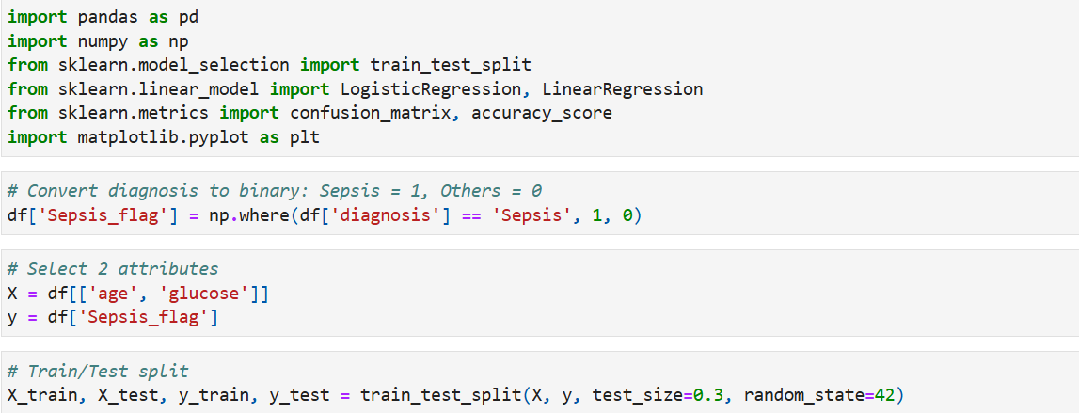
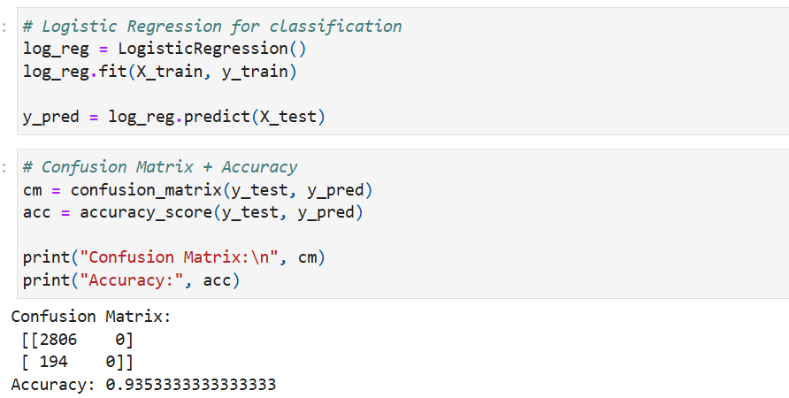
Linear Regression

Slide 15
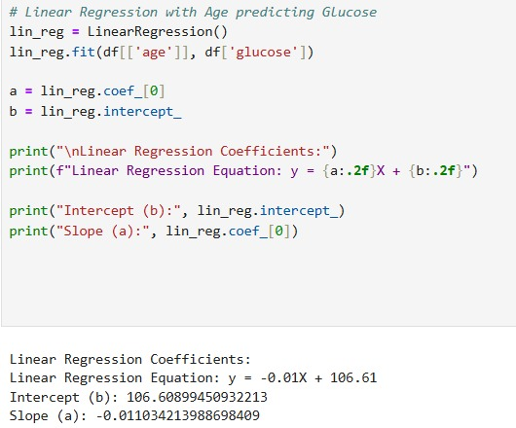
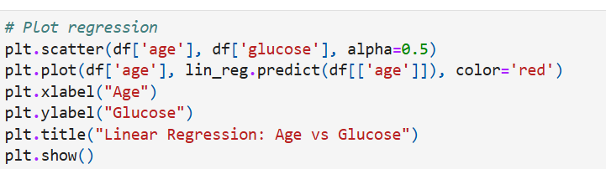

Slide 16
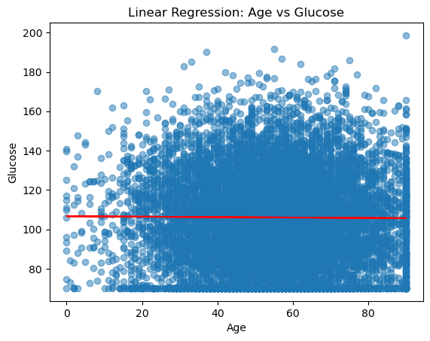
Interpretation: The confusion matrix shows that the logistic regression model achieves high accuracy in predicting non-sepsis patients but struggles to correctly classify true sepsis cases due to class imbalance. This indicates that while the model is reliable at identifying healthy patients, it misses many actual sepsis cases, limiting clinical usefulness. The linear regression between Age and Sepsis produced a nearly flat line (𝑦=0.0001𝑋+0.0607y=0.0001X+0.0607), showing that age alone is not a strong predictor of sepsis. Similarly, the regression of Age vs Glucose (𝑦=−0.01𝑋+106.61y=−0.01X+106.61) shows only a very weak negative trend, with glucose values scattered across all ages. Overall, both analyses highlight that single variables such as age or glucose have little predictive power, and more features must be included to build a stronger sepsis prediction model.

Slide 17
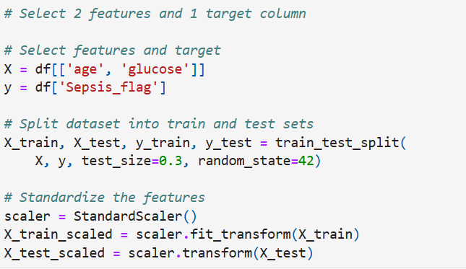
Feature Selection and Target column
In this step, we performed classification to predict the likelihood of Sepsis using two selected features.
Selected Features: age, glucose
Target Column: Sepsis_flag (1 = Sepsis, 0 = No Sepsis)
Train-Test Split: 70% training, 30% testing
Data Preprocessing: Standardized using StandardScaler

Slide 18
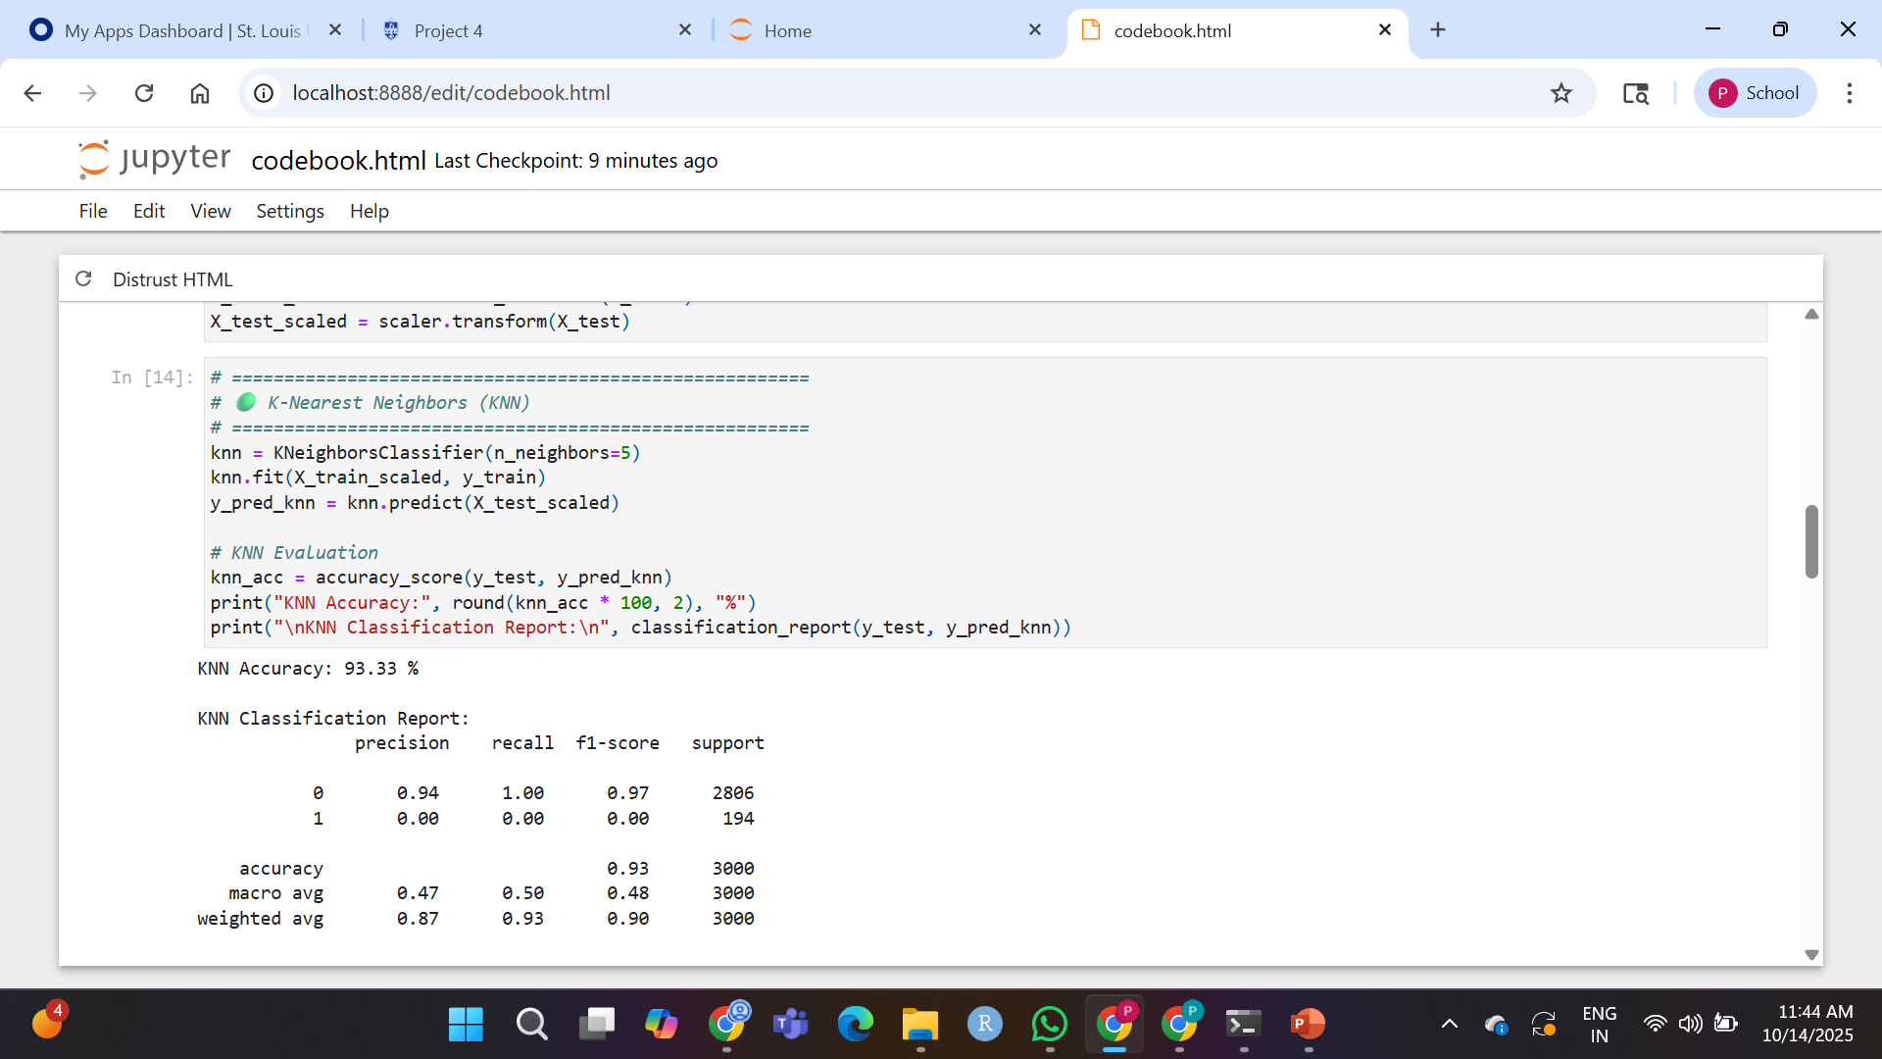
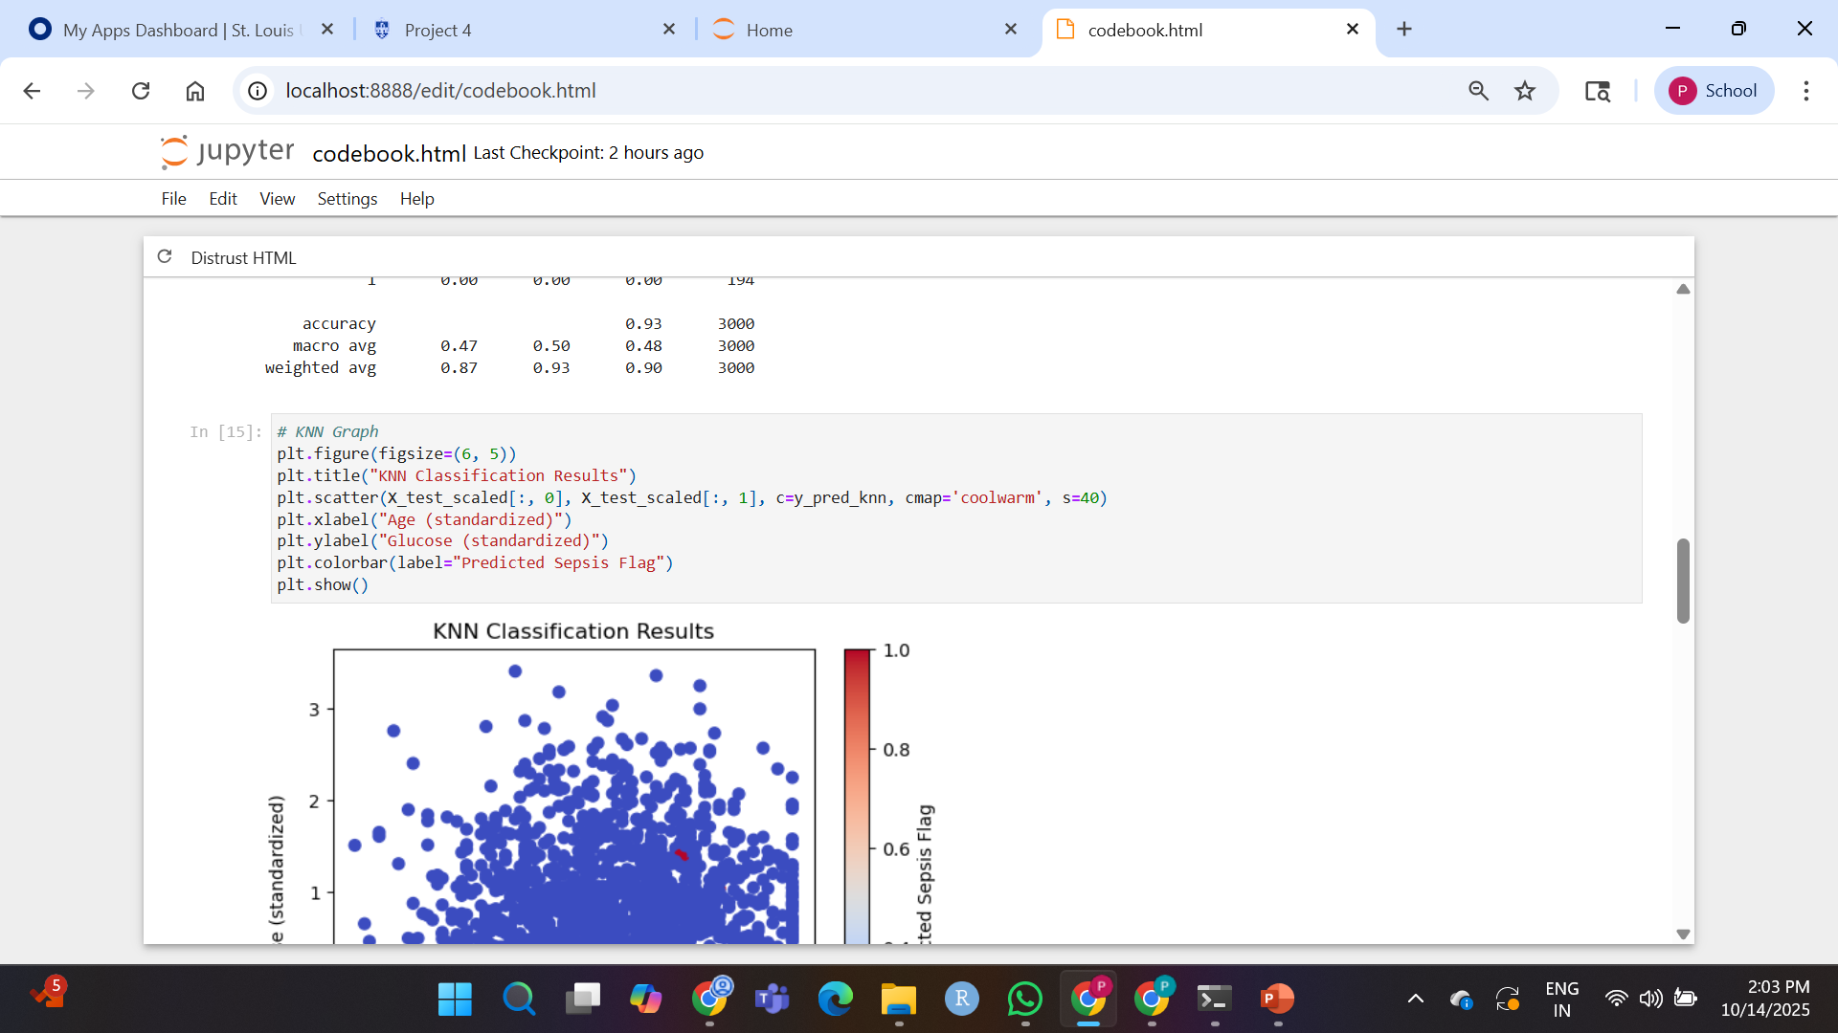
Classifying the Data using KNN Method

Slide 19
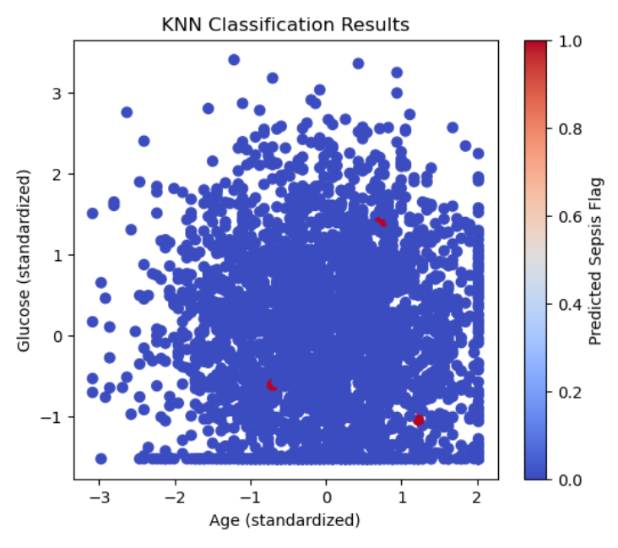
KNN Classification Scatter Plot
X-axis: Age (standardized)
Y-axis: Glucose (standardized)
The points are colored based on predicted class

Slide 20
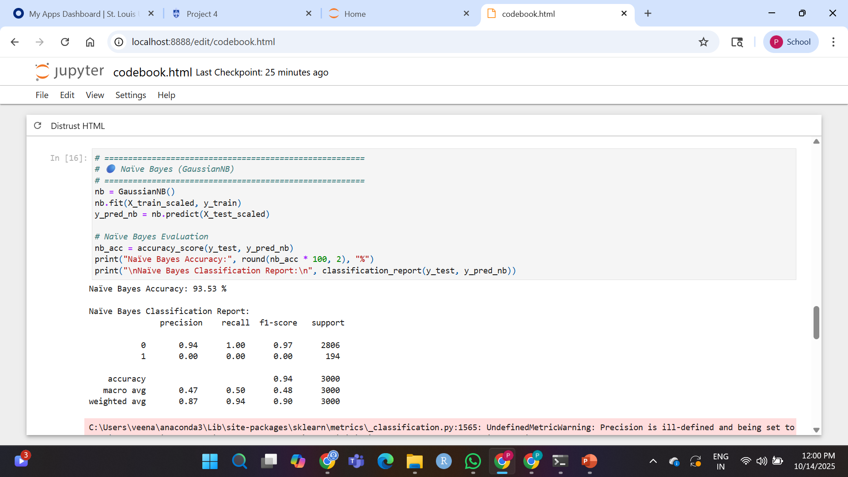
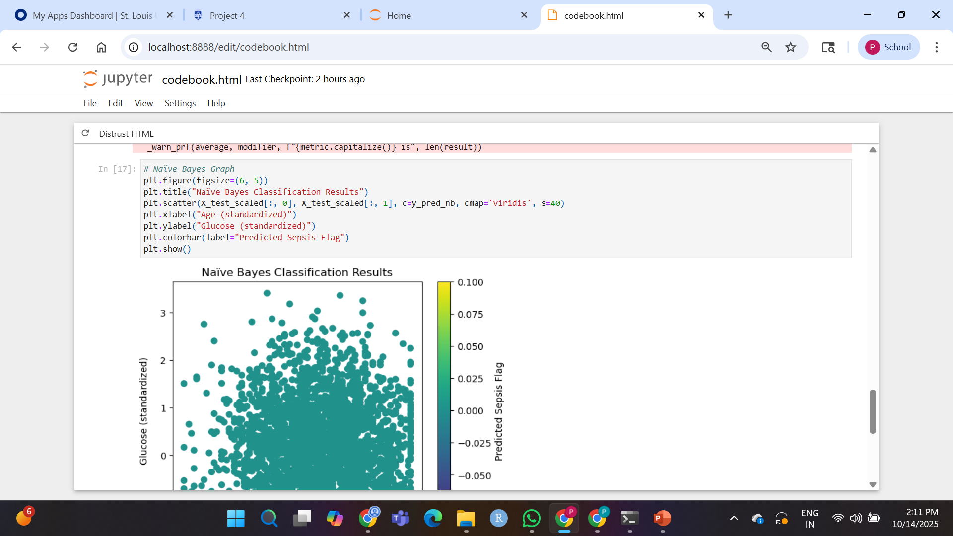
Classifying the Data using Naïve Bayes Method

Slide 21
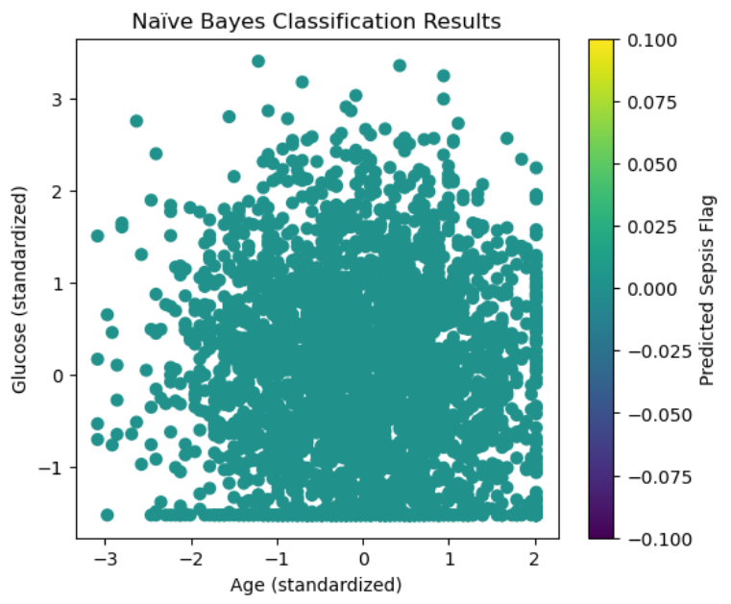
Naïve Bayes Classification Scatter Plot
X-axis: Age (standardized)
Y-axis: Glucose (standardized)
Points colored based on predicted class

Slide 22
Accuracy of the models

Slide 23
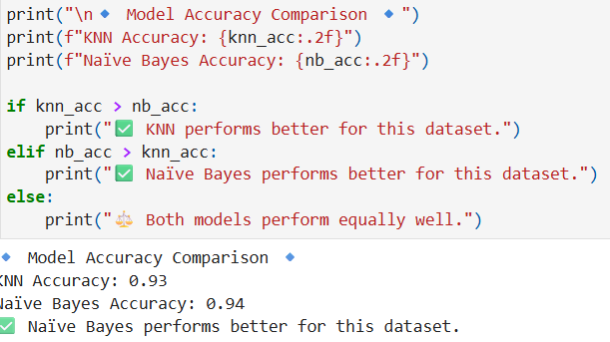
Model Comparison
Both models achieved high accuracy (>93%)
However, they failed to detect Sepsis cases well due to class imbalance
Naïve Bayes performed slightly better than KNN

Slide 24
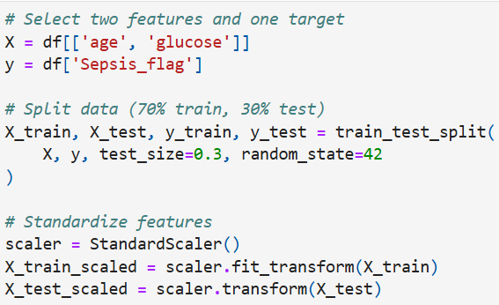
Feature Selection and target column for SVM

Slide 25
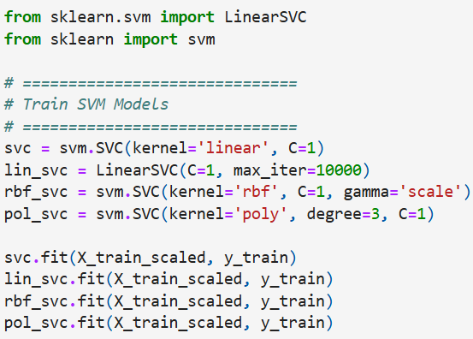
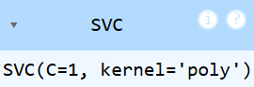
4 SVM models with different kernels

Slide 26
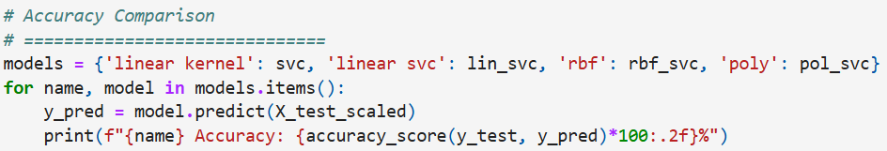
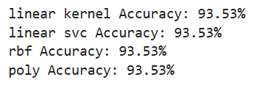
Accuracy Comparison

Slide 27
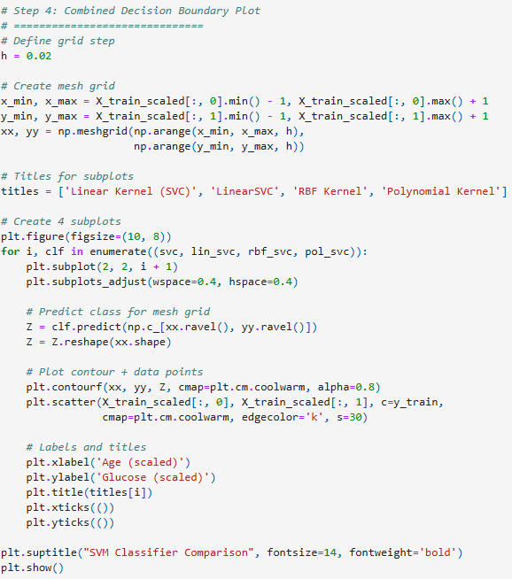
SVM Classifier Comparison

Slide 28
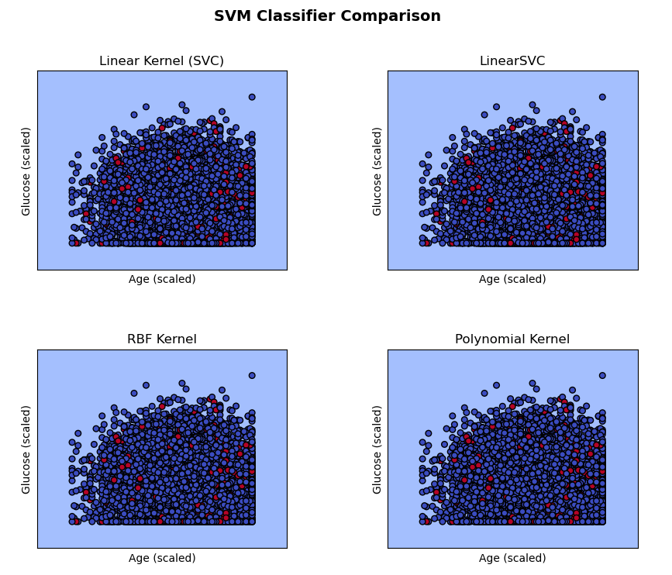
SVM Classifier Comparison Visualization

Slide 29
Interpretation
Four SVM models—Linear (SVC), LinearSVC, RBF, and Polynomial—were trained using the features Age and Glucose to predict Sepsis_flag.
Each subplot visualizes the decision boundary formed by its respective kernel.
All four classifiers show almost identical separation between the two classes, indicating linear separability in the data.
The Linear and Non-linear (RBF, Polynomial) kernels produce similar boundaries with no significant gain in accuracy.
This suggests that a simple linear model is sufficient for this dataset.
Therefore, increasing model complexity using nonlinear kernels does not improve performance since the classes are already well separated.

Slide 30
Result
All four SVM models (Linear, LinearSVC, RBF, Polynomial) achieved similar accuracy of around 93.5%.
The decision boundaries in all plots appeared nearly identical, indicating linear separability.
Complex kernels like RBF and Polynomial did not improve performance.
Hence, the Linear SVM provides the best balance of simplicity and accuracy for this dataset.

